Slide 1
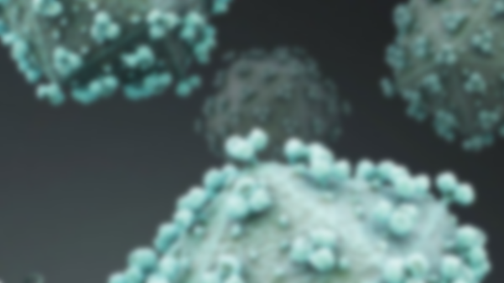
HIV TRANSMISSION NETWORK
Giulia Xixi Curtolo
Patricia Nita
Gabriel Cristian Circiu
Mykyta Taranov

Slide 2
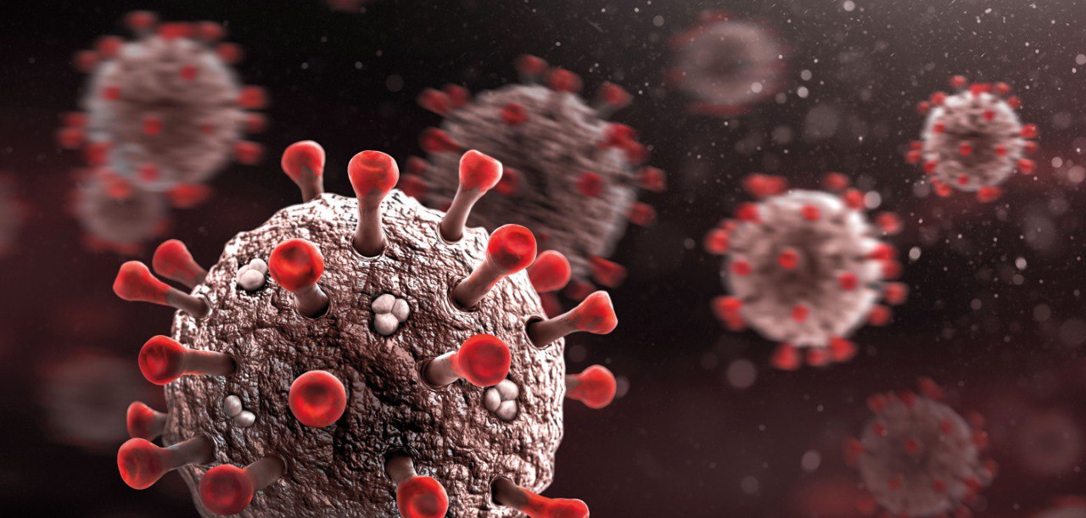
Contents
Network Introduction
Centralities
Communities
Power Law
Research Question
SIR Model
SIR+ Model
Conclusion
Further Work

Slide 3
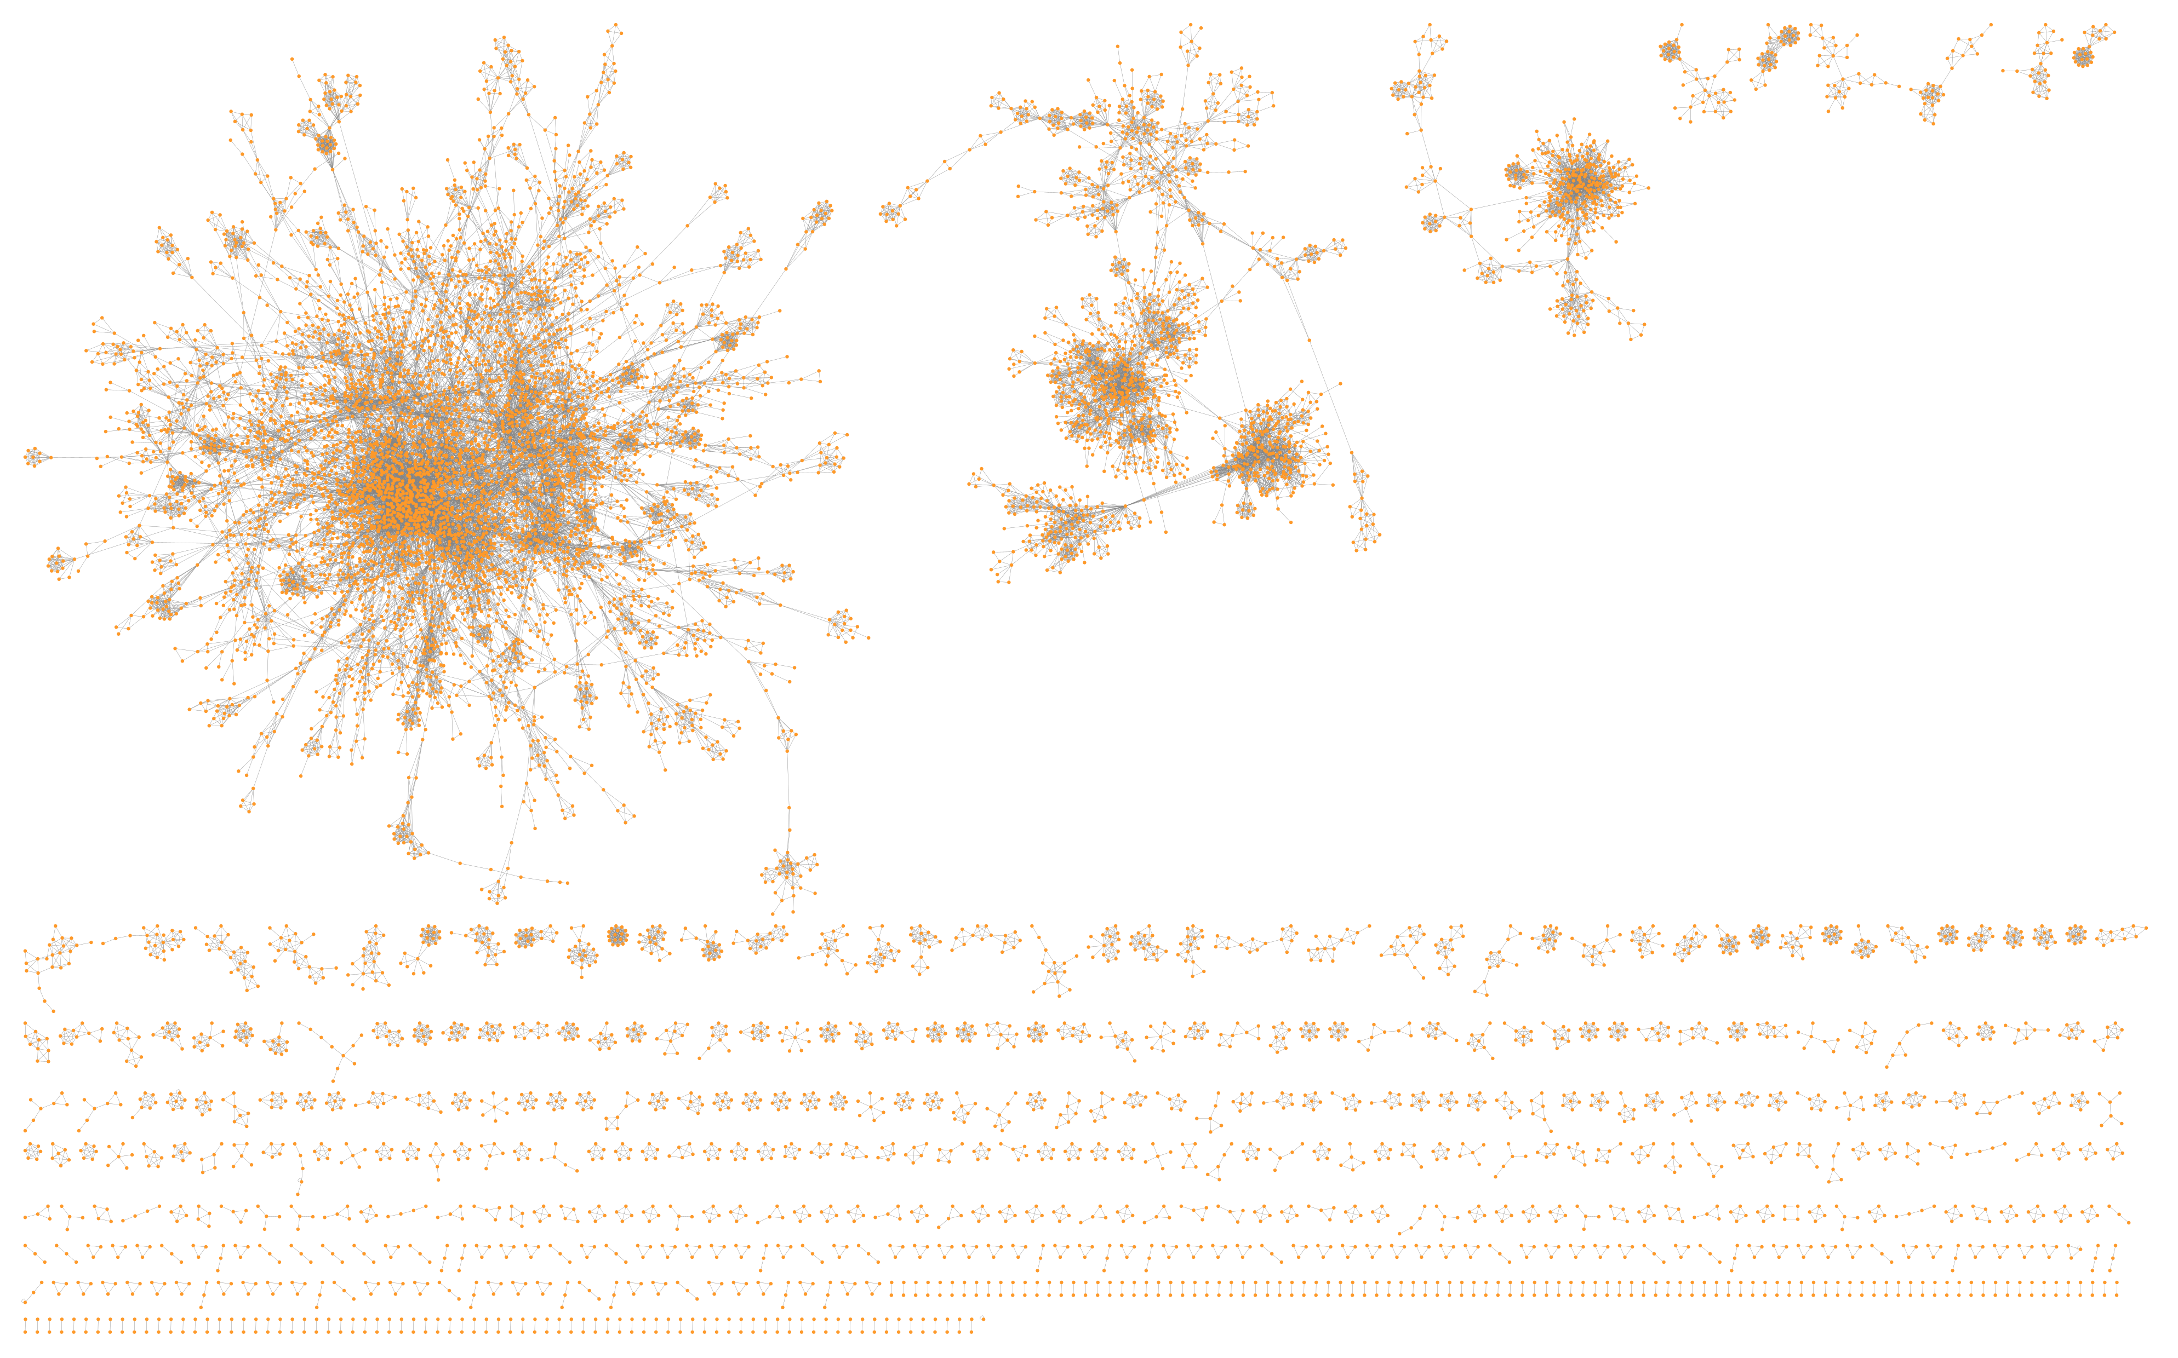
Network Introduction
Collection of datasets gathered between 1988-2001, organized into 3 networks:
DS1 Person (meta data about each node / participants in survey)
DS2 Pairs of persons - Egodyads
DS3 Pairs of persons – Alterdyads
Undirected, unipartite network
Interviewees + listed partners edgelist
121028 original edges

Slide 4
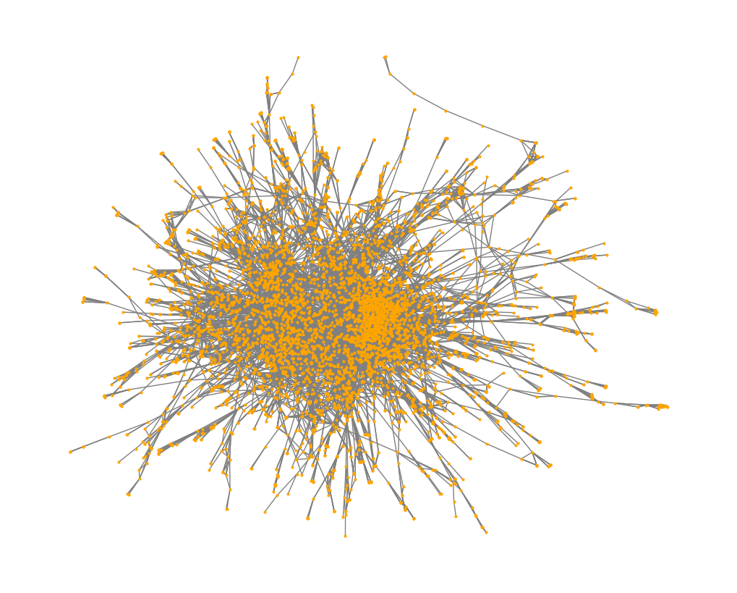
Our Network (Largest Connected Component)
5743 nodes
22710 edges
Average degree: 7.91
Median degree: 6
Avg. Path Length: 6.89
Diameter: 21
Global clustering coefficient: 0.407
Top degree centrality nodes:
'283': 0.036, 204 (degree)
'618': 0.028, 158
'266': 0.026, 150
'389': 0.022, 128
'16': 0.016, 97

Slide 5
Other Centrality Measures
Top closeness centrality nodes:​
'283': 0.2444
'77': 0.2378
'94': 0.2374
'266': 0.2371
'618': 0.2370
Top betweenness centrality nodes:​
'283': 0.1057
'94': 0.1041
'618': 0.0879
'48': 0.0762
'938': 0.0705

Slide 6
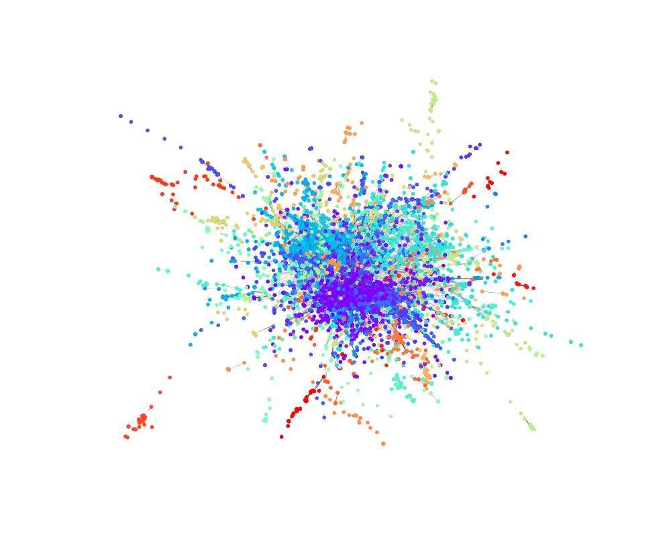
Communities
~95 communities
Average communities size: 69.1,
Size range: 4-661
Largest community sizes: 661, 266, 264
Modularity: 0.87

Slide 7
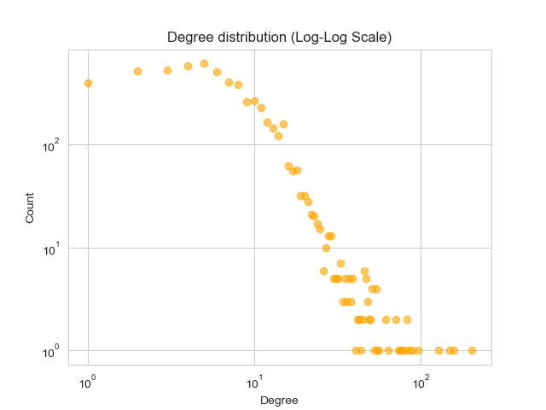
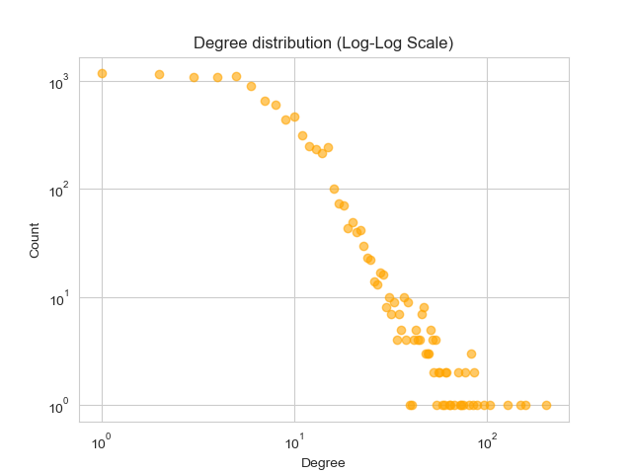
Degree Distributions
Largest Component
Entire Network

Slide 8
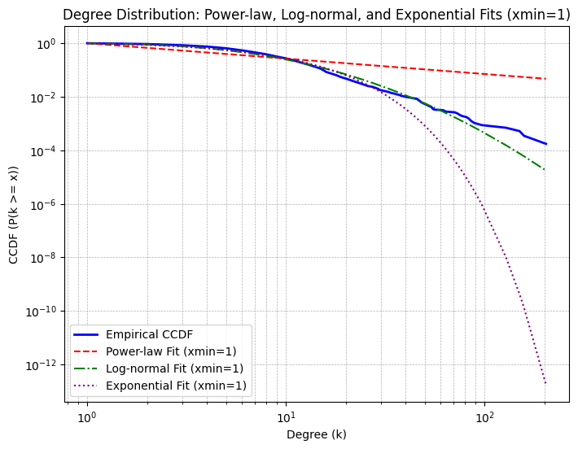

Power-Law?
Power-law vs Exponential: R = -2062.01, p = 0.0000
Power-law vs Log-Normal: R = -2042.88, p = 0.0000
Log-Normal vs Exponential: R = -19.13, p = 0.5524
Power-law KS test: D = 0.3096, p-value = 0.0000
Log-normal KS test: D = 0.0850, p-value = 0.0000
Exponential KS test: D = 0.1569, p-value = 0.0000

Slide 9
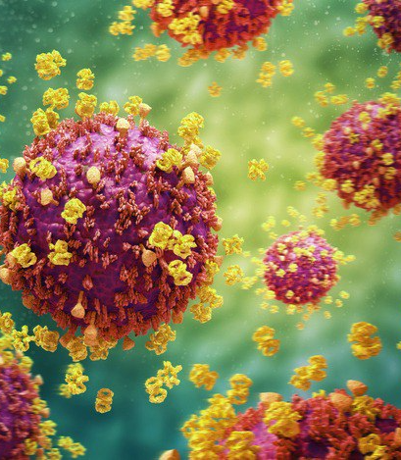
Research Question
What changes can we observe within this network in regards of the spread of HIV, given a random subset of people being infected or protected?
What changes can we observe in the spread of HIV, within the network, given different strengths of protection and rates of their spread?

Slide 10
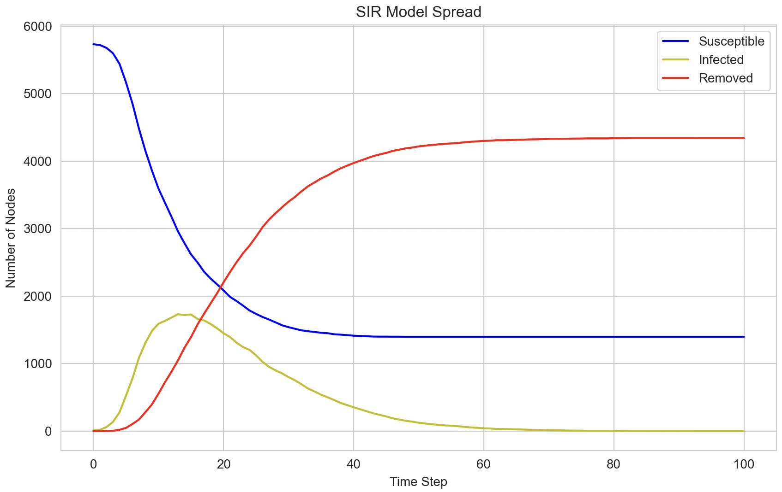
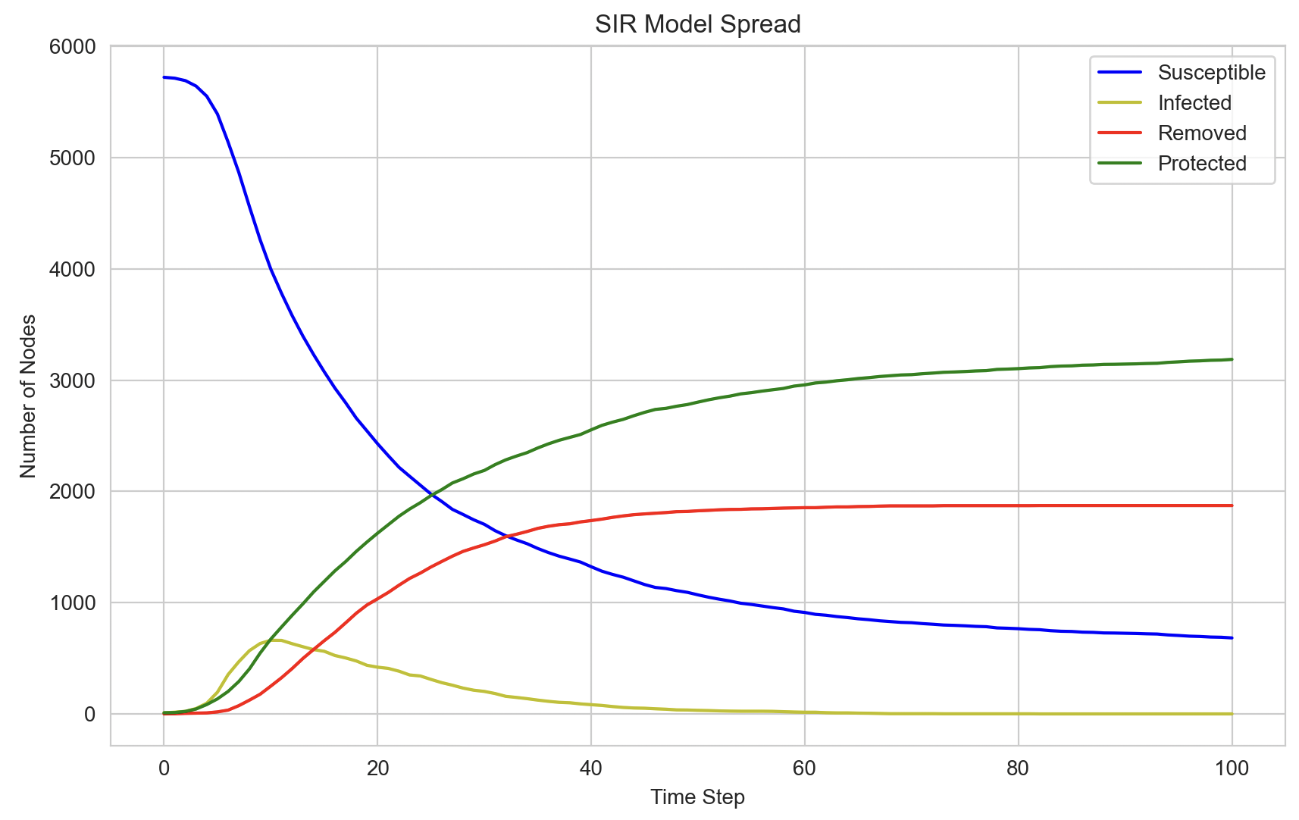
SIR Model
Without Protection
With Protection
Initial Infected: 10
Infection spread chance: 0.1
Initial Protected: 0
Protection spread chance: 0
Initial Infected: 10
Infection spread chance: 0.1
Initial Protected: 10
Protection spread chance: 0.05

Slide 11
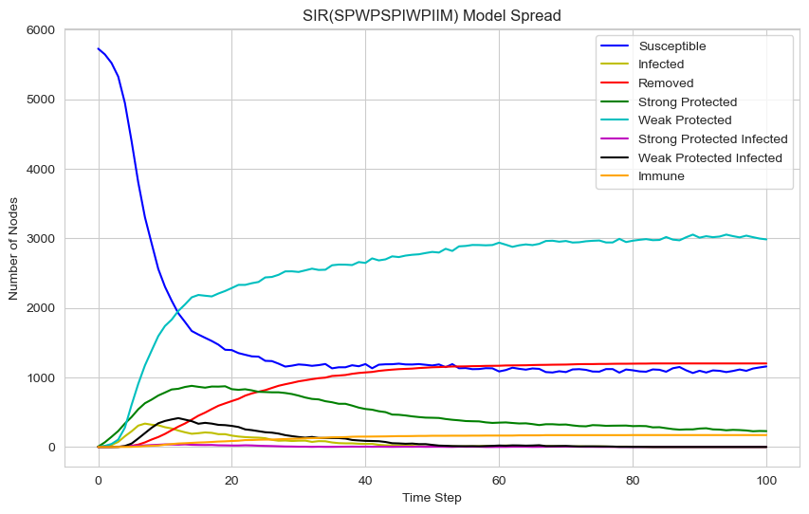
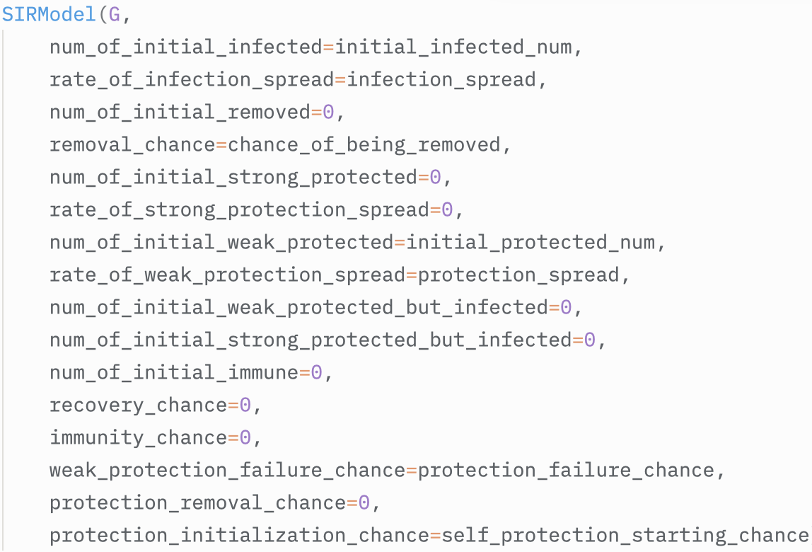
SIR... SPWPSPIWPIIM Model...?
When is it too much?
However...

Slide 12
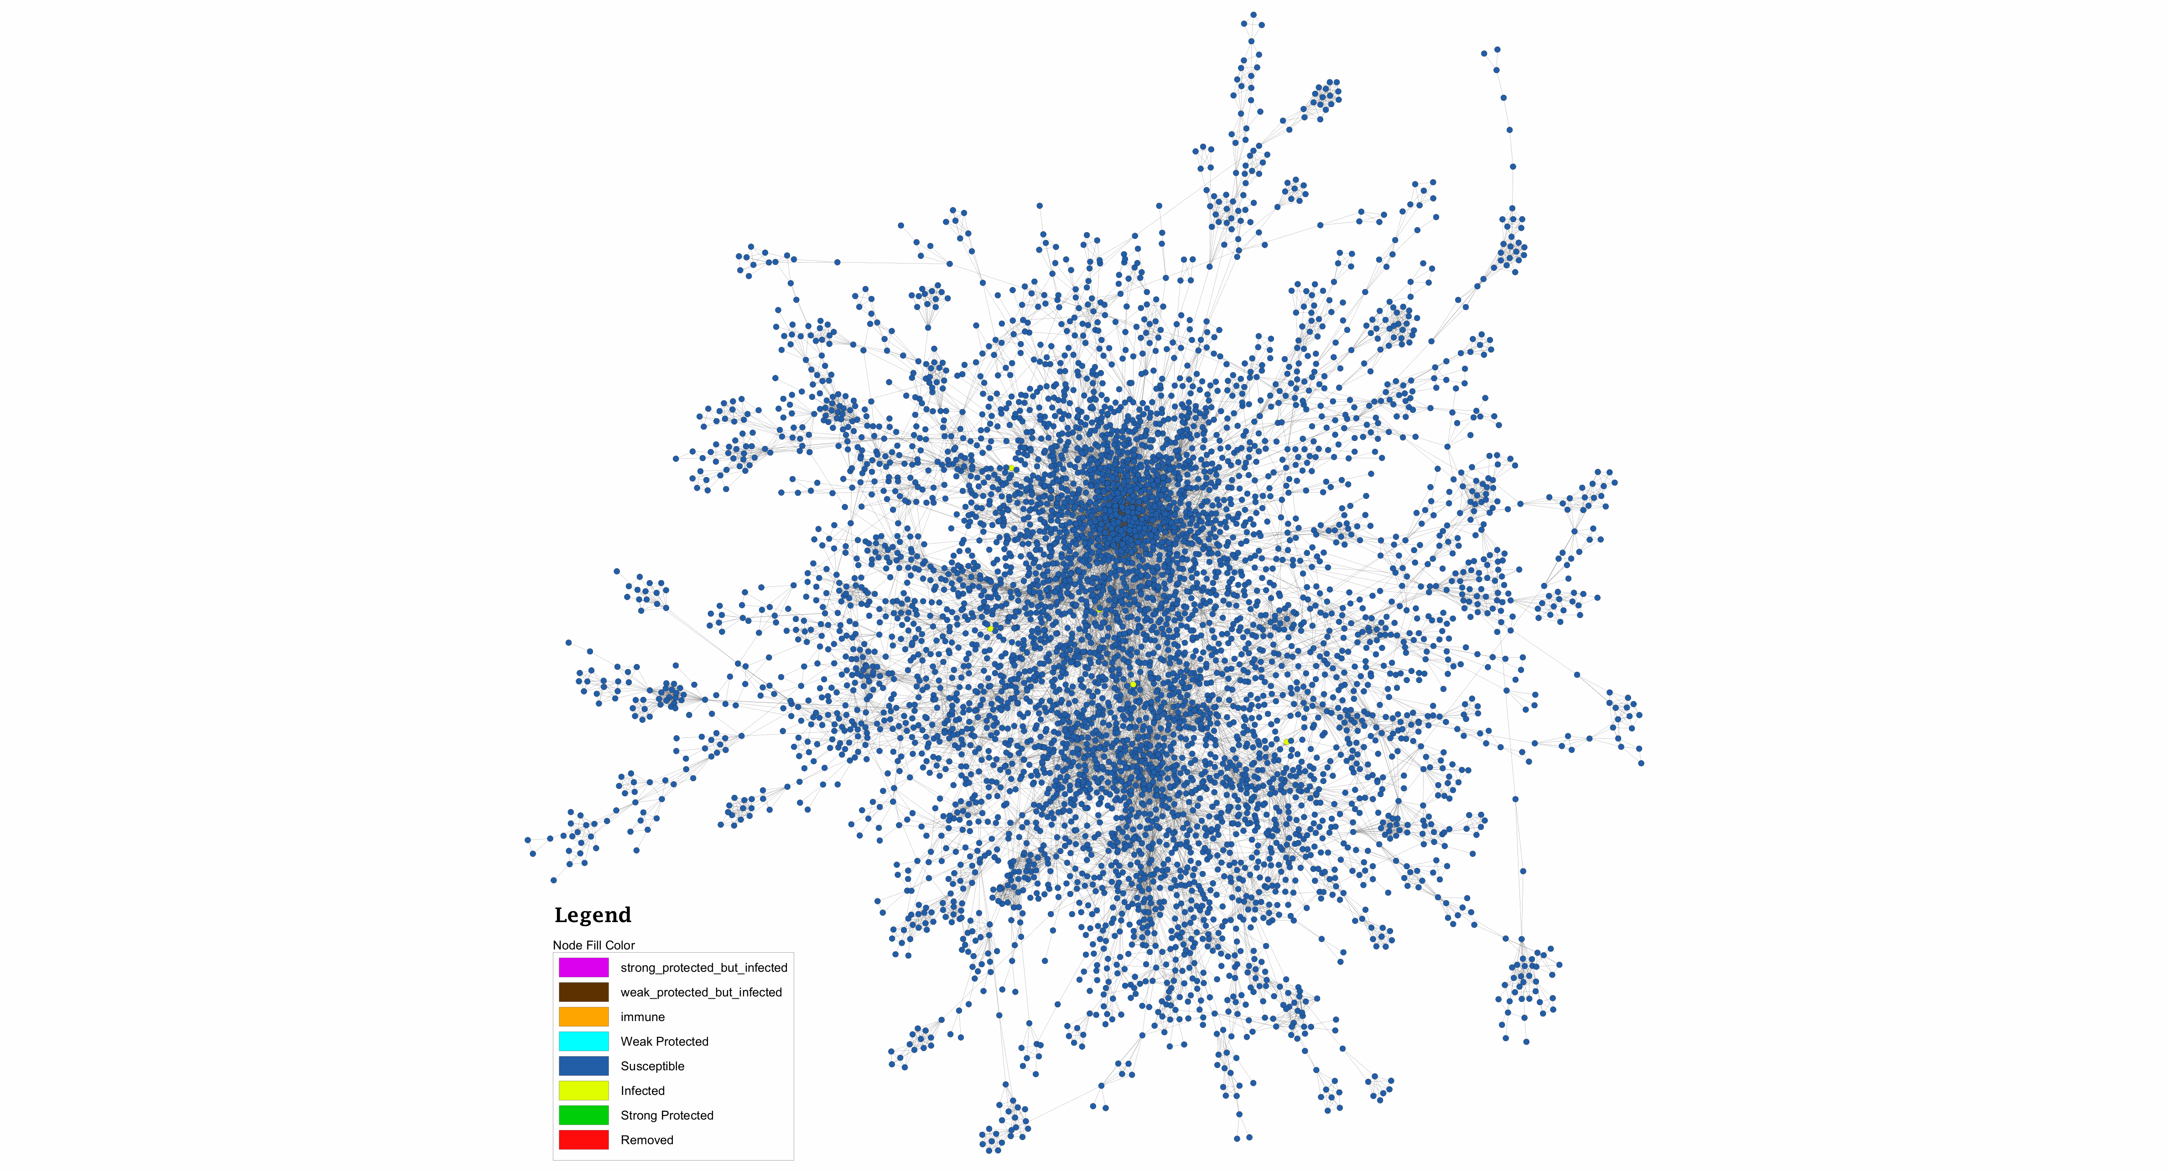
SIR Model
(first 30 cycles)

Slide 13
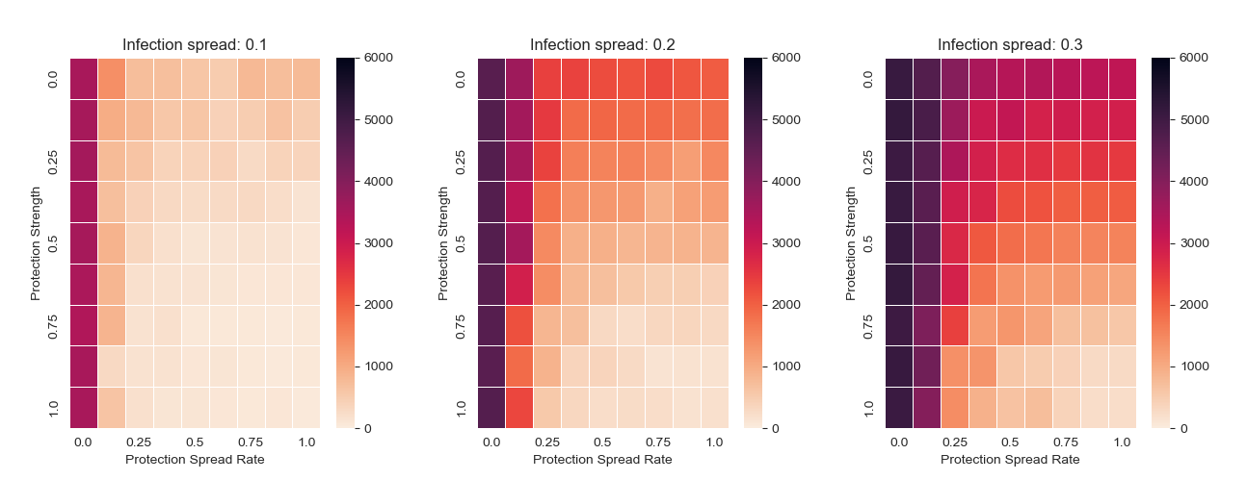
SIR+ Model

Slide 14
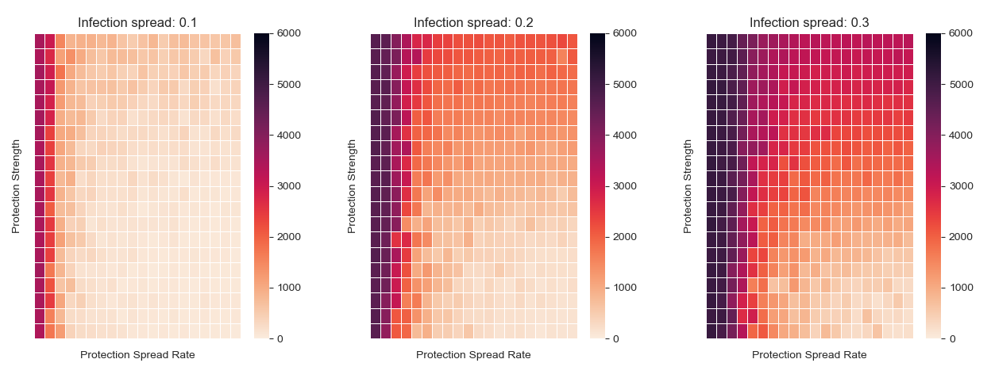
SIR+ Model
0.68
0.78
0.52
0.57
0.157

Slide 15
Interpretation & Conclusion
For low (<=0.1) infection spread rate
Protection spread rate is key
Even minimal protection is useful
Protection strength is mostly insignificant
For high infection spread rate
Protection spread rate is still most important
Protection strength now also a key factor

Slide 16
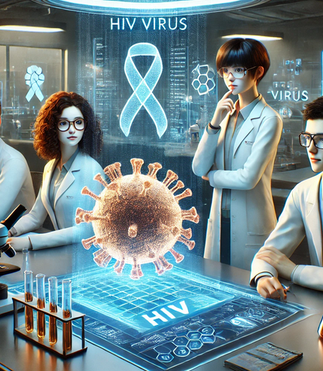
Future work
Analyze metadata for more insights
Does method of transmission matter? (needle, sexual, etc.)
Could age, gender, orientation etc. matter?
Compare how communities differ in HIV spread
Targeted protection or infection of specific nodes
Test protection strategies for high-risk groups

Slide 17
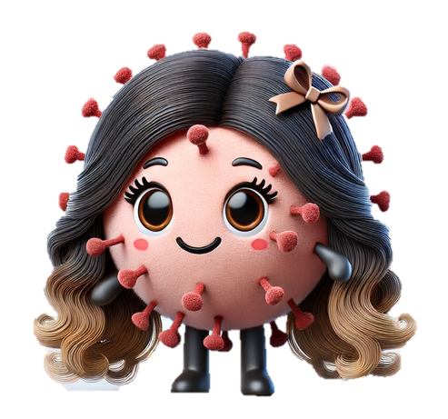
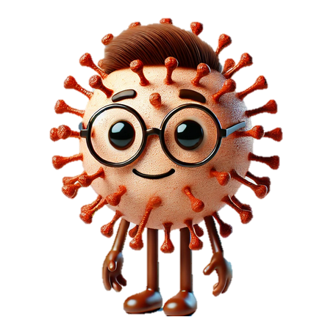
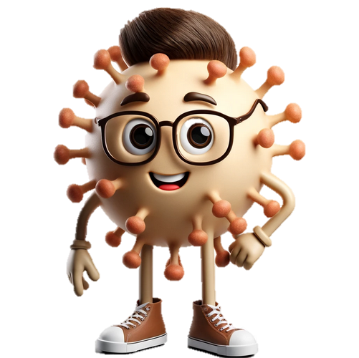
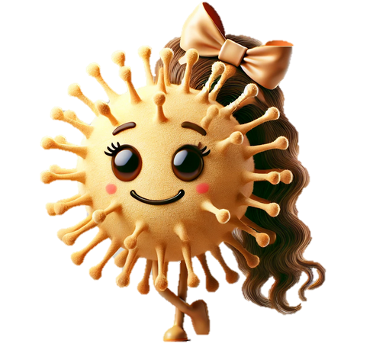
Thank you for your attention!
References: GitHub Repo; Images generated by ChatGPT (with DALL-E), prompts available on GitHub repo.

